Slide 1
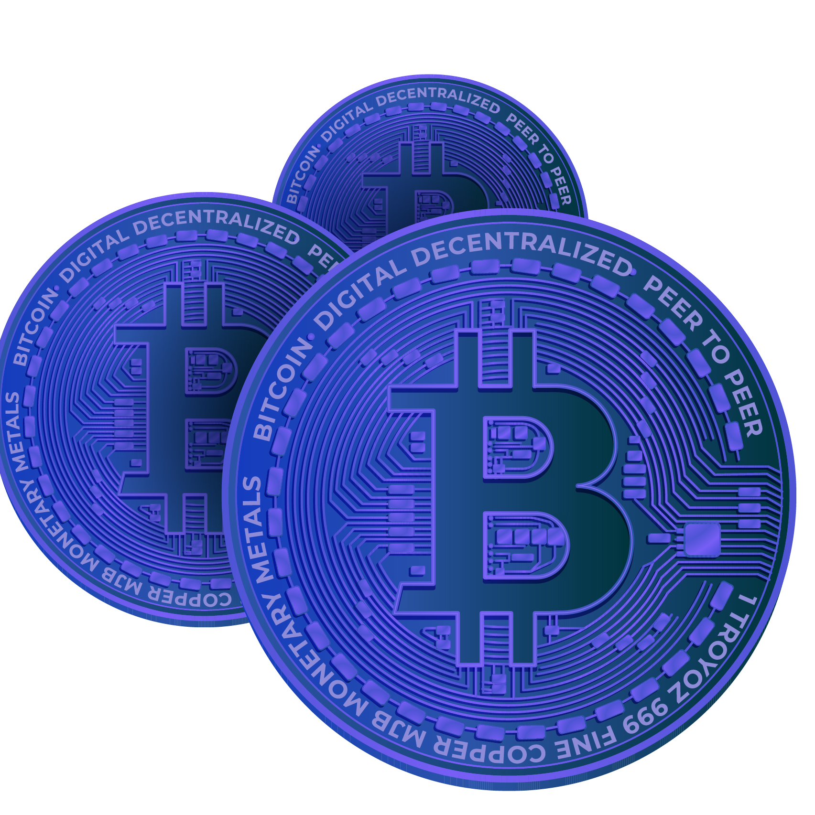
Cryptocurrency The currency of the future
Notes:
1. Table of contents
2. Introduction
3. Our company
4. Our team
5. Problem
6. Them vs. us
7. Solution
8. SWOT analysis
9. Product overview
10. Our plans
11. Product demo
12. Traction
13. Case study
14. Reviews
15. Awards
16. Market size
17. Target
18. Competitors
19. Business model
20. Timing
21. Predicted growth
22. Investment

Slide 2
Presented By
Name | Roll
Arnob Biswas | 2267
Md. Tariful Islam | 2268
Tanjid Hasan | 2269
Mehedi Hassan | 2310
Naim AL Hakim | 2311
Mozadded UL Islam | 2276
Shariul Islam | 2020

Slide 3
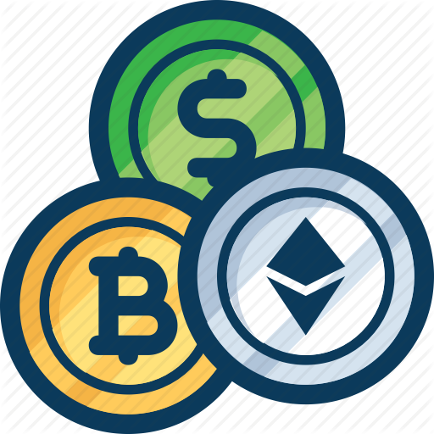
Introduction
Cryptocurrency, or digital currency that uses cryptography for security, has emerged as one of the most significant technological and economic innovations of the past decade. Since the launch of Bitcoin in 2009, hundreds of new cryptocurrencies have emerged, each with unique features and use cases. While cryptocurrencies have faced numerous challenges and controversies, including regulatory scrutiny and price volatility, their future remains bright.
Popular Cryptocurrencies
Ethereum
BitCoin

Slide 4
Advantages of Cryptocurrency
Cryptocurrencies appeal to their supporters for a variety of reasons. Here are some of the most popular:
Supporters see cryptocurrencies such as bitcoin as the currency of the future and are racing to buy them now, presumably before they become more valuable
Some supporters like the fact that cryptocurrency removes central banks from managing the money supply, since over time these banks tend to reduce the value of money via inflation

Slide 5

BitCoin
Bitcoin is software-based online payment system described by Satoshi Nakamoto in 2008 and introduced as open-source software in 2009. It is a form of digital currency created and held electronically.

Slide 6
Features of Bitcoin
Bitcoin has several features that set it apart from fiat currencies:
It is decentralized
It is easy to set up and it is fast
It is anonymous
It is completely transparent
Transaction fees are miniscule
Transactions are irreversible

Slide 7
Block Chain
Bitcoin is a network that runs on a protocol named “block chain”.
Blockchain, sometimes referred to as Distributed Ledger Technology (DLT)

Slide 8
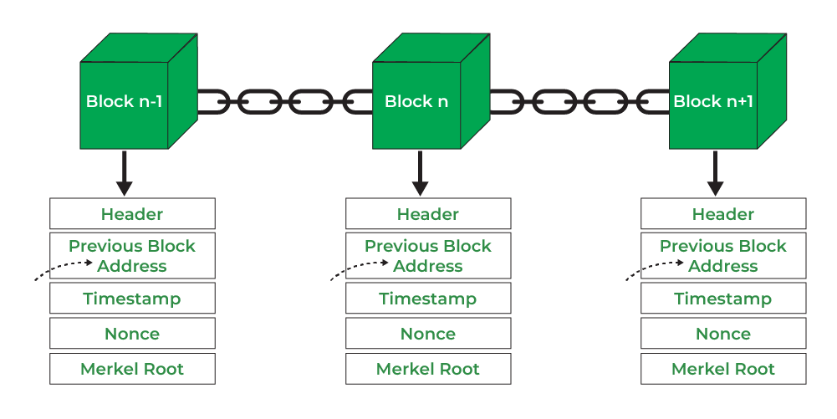
Diagram of Block Chain
Fig: Diagram of Block Chain

Slide 9
Challenges of Cryptocurrency

Slide 10
Volatility
Cryptocurrencies are known for their high level of volatility, which can make them a risky investment. The value of cryptocurrencies can fluctuate rapidly, which can make it difficult for investors to predict their returns. This volatility is often attributed to a lack of liquidity in the market, which makes it easier for traders to manipulate prices.

Slide 11
Regulatory Uncertainty
Cryptocurrencies are still largely unregulated in many parts of the world, which can make it difficult for businesses and investors to know how to navigate the market. The lack of clear regulations can also make it easier for fraud and criminal activities to take place. Governments around the world are starting to develop regulations for cryptocurrency, but this is still a work in progress.

Slide 12
Security
Cryptocurrency exchanges and wallets are vulnerable to hacking and fraud, which can result in the loss of funds. While the blockchain technology that underpins cryptocurrencies is secure, the exchanges and wallets that store them are often not. In order to address this challenge, new security measures such as two-factor authentication and multi-sig wallets have been developed, but more needs to be done to ensure the safety of users' funds.

Slide 13
Adoption
While cryptocurrency has been around for over a decade, it is still not widely adopted as a mainstream technology. Many people are still unfamiliar with how to use it, and there are limited use cases for it beyond investment and speculation. In order for cryptocurrency to be widely adopted, it will need to be easier to use and more widely accepted as a payment method.

Slide 14
Future of Cryptocurrency

Slide 15
Institutional Adoption
As traditional financial institutions invest in cryptocurrencies and blockchain technology, we can expect to see increased liquidity and stability in the market. This is because institutional investors bring more capital and resources to the market, which can help to reduce volatility and increase confidence in the technology. Moreover, their involvement can also help to improve the overall perception of cryptocurrencies as a legitimate investment asset class.

Slide 16
Government Regulations
While the decentralization and anonymity of cryptocurrencies have been a key selling point, it has also made the market vulnerable to fraud, hacking, and other criminal activities. To mitigate these risks, governments around the world are expected to develop regulations to govern the use of cryptocurrencies. This is likely to result in a more stable and secure environment for investors and users. Additionally, clear regulations may also help to encourage institutional adoption of cryptocurrencies.

Slide 17
Increased Scalability
Scalability is one of the biggest challenges facing the cryptocurrency market. As the number of users and transactions grows, the blockchain networks that underpin cryptocurrencies may become congested, leading to slow transaction times and high fees. Developers are working on solutions to this problem, such as implementing layer 2 solutions like the Lightning Network, which will allow for faster
and more cost-effective transactions

Slide 18
Interoperability
Currently, there are many different cryptocurrencies, and they often operate independently of each other. This can make it challenging for users to transact between different cryptocurrencies. However, in the future, we can expect to see increased interoperability between different cryptocurrencies, which will allow for greater flexibility and ease of use. This could be achieved through cross-chain technology, which allows for the seamless exchange of assets between different blockchains

Slide 19
Decentralized Finance
DeFi is a fast-growing area of the cryptocurrency market that allows users to lend and borrow money, trade assets, and earn interest, all without relying on traditional financial institutions. As more people adopt DeFi, we can expect to see new use cases and applications emerge. For example, DeFi platforms could potentially provide access to financial services for people who are unbanked or underbanked, which could help to increase financial inclusion.

Slide 20
Centralized Bank Digital Currency
Many central banks around the world are exploring the possibility of creating their own digital currencies. CBDCs could potentially provide a more secure and efficient payment system, and could also help to reduce the use of cash. However, the development of CBDCs could also have implications for the existing cryptocurrency market, as it could potentially provide competition for existing cryptocurrencies.

Slide 21
Conclusion
The future of cryptocurrency is exciting and full of potential. While there are still challenges and uncertainties to be addressed, such as scalability and government regulations, the cryptocurrency market is expected to continue to grow and evolve in the years to come. As more people adopt cryptocurrency and blockchain technology, we can expect to see new use cases and applications emerge, which could have far-reaching implications for the financial industry and beyond.

Slide 22
THANKS

